Slide 1

INFORMATION SYSTEMS
Overview
Information Systems and Management

Slide 2
An Introduction to Information Systems
Information System:
  An information system is a set of interrelated components that collect, manipulate, store data and disseminate information and provide a feedback mechanism to monitor performance.

Slide 3
What is an Information System?
An organized combination of people, hardware, software, communications networks, and data resources that collects data, transforms it, and disseminates information.

Slide 4
Data Vs. Information
Data: Raw unorganized facts
Information:
A collection of facts organized in such a way that they have additional value beyond the value of the facts themselves.
Defining and organizing relationships among data creates information.

Slide 5
Information Concepts
Process:
A set of logically related tasks performed to achieve a defined outcome.
Knowledge:
An awareness and understanding of a set of information and ways that information can be made useful to support a specific task or reach a decision

Slide 6
The Value of Information
The value of Information
is directly linked to how
it helps decision makers
achieve their organization’s
goals.

Slide 7
System
A system is a set of elements or components that interact to accomplish goals.

Slide 8

CBIS
Hardware:
Computer Equipment
Software:
Computer Programs
Databases:
An organized collections of facts

Slide 9

CBIS
Telecommunications:
Electronic transmission of signals for communication
      Networks: Distant electronic communication
      Internet: Interconnected Networks
      Intranet: Internal Corporate Network
      Extranet: Linked Intranets

Slide 10

CBIS
People
Procedures:
Strategies, policies, methods, and rules for using a CBIS.

Slide 11
Business Information Systems

Slide 12
Electronic and Mobile Commerce
E-Commerce:
Any business transaction executed electronically
M-Commerce:
Transactions conducted anywhere, anytime
        Relies on wireless communications

Slide 13
TPS and ERP
Transaction
  business related exchange
  Evidence of a business event
Transaction Processing System (TPS)
  A system which records completed business transactions
Enterprise Resource Planning (ERP)
  A set of integrated programs for managing the entire business operations

Slide 14
Business Information Systems
Management Information System:
A system used to provide routine information to managers and decision makers
Decision Support System:
A system used to support problem- specific decision making

Slide 15
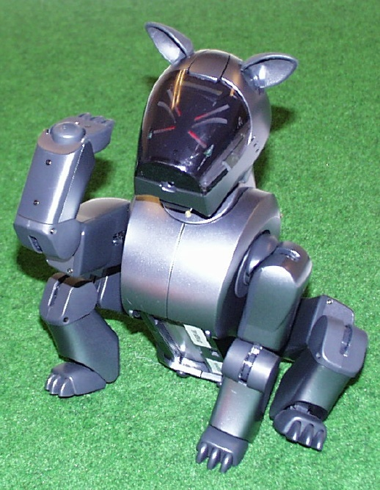
Specialized Business I.S.
Artificial Intelligence (AI):
A field in which the computer takes on the characteristics of human intelligence

Slide 16
Expert System:
A system that gives a computer the ability to make suggestions and act like an expert in a particular field.
Knowledge Base:
      The collection of data, rules, procedures, and relationships that must be followed to achieve value or the proper outcome.

Slide 17
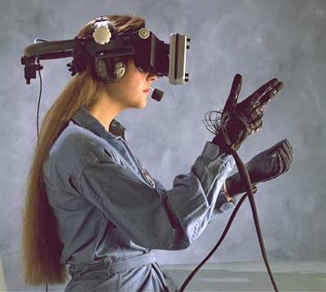
Virtual Reality:
The simulation of a real or imagined environment that can be experienced visually in three dimensions

Slide 18
Systems Development

Slide 19
Systems Development:
The activity of creating or modifying existing business information systems

Slide 20
Systems Investigation and Analysis
Understand the problem
and potential solutions

Slide 21
Systems Design, Implementation, Maintenance and Review
  Determine how the new system will meet business needs
  Put the new system into operation
  Ensure the system continues to meet changing business needs

Slide 22
Information Systems in Society
Security, Privacy, Ethical Issues in Information Systems and the Internet.

Slide 23
Computer Literacy:
Knowledge of computer systems and equipment and the ways they function

Slide 24
General Information Systems Diagram
Management Decisions
(Environment)
Data
Input
Process
Output
Information
Control
Feedback

Slide 25
Data:
Raw unorganized facts
Information:
Data organized in a meaningful way for the user (in consideration of the environment)

Slide 26
Informal Information System
Each organization has a unique culture, or fundamental set of assumptions, values, and ways of doing things, that has been accepted by most of its members

Slide 27
Environment:
    Business - other functional areas
    Computer – hardware, software, other IS
Sub System:
Component of a larger system
System Boundary:
Interaction with environment (user or other system) via an interface

Slide 28
Information System Activities
Input of Data Resources
Process Data into Information
Output of Information

Slide 29
Input of Data Resources
Data entry
Editing
Machine readable
Source documents
  Formal record of a transaction
User interface
  How users interact with information system
  Optical scanning; menu; prompts; fill in blanks

Slide 30
Process Data into Information
Calculate
Compare
Sort
Classify
Summarize
The quality of the data must be maintained by a continual process of correcting and updating activities

Slide 31
Output of Information
Transmit information to users
  Display; paper; audio
Storage of data
  Data are retained in an organized manner
    Fields; records; files; data bases
Control of system performance
  Feedback must be monitored and evaluated to determine if the information system is meeting established performance standards

Slide 32
Systems Applications in the Organization
Decisions
Management Levels
Information Systems
Unstructured
Senior Management
ESS
Strategic
DSS
Knowledge and Data Worker
GIS, CAD/CAM, OAS
Tactical
Middle
Management
MIS
Lower
Management
TPS
Technical
(Operational)
Buy
Make
Sell
Keep
Track
Functions
Structured

Slide 33
INFORMATION SYSTEMS
Overview
Information Systems and Management

